Slide 1
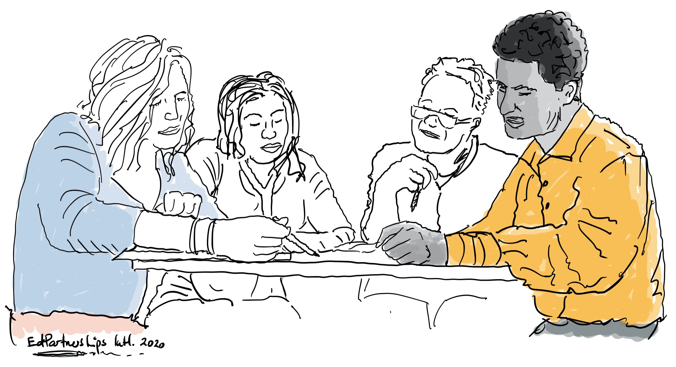
LFA 1.3 Note Taking and Discussion Scaffold
What can we learn from other school communities, the educational evidence base and system level policy and guidance?
Individual Version

Slide 2
Individual LFA 1.3 booklet
What have we learned that helps us to re-imagine more meaningful reporting (processes and products) with and for our families?
From other schools?
From the educational evidence base?
From the system level?

Slide 3
Individual LFA 1.3 booklet
After engaging with the ACER report and school case studies, the team is invited to individually respond to the following prompts:
What are you now noticing tends to be privileged in your local reporting processes and documentation? Implications?
To what extent is a holistic understanding of each learner communicated through your reports and reporting processes? How might this be further strengthened?
What is something from the ACER report that is worth considering in your context? Why? How might you approach this?
What further questions, wonderings or challenges have arisen in light of reading this report?
Share and discuss your responses, the add your main insights and ideas to the Investigation Team Summary version of this document.

Slide 4
Individual LFA 1.3 booklet
After engaging with the system documents, the team is invited to individually respond to the following prompts:
To what extent are our current reports accessible and easy for parents and carers to understand? What might require further strengthening and how might this work be undertaken and by whom?
How might parent/carer learning partnerships be further strengthened in assessment and reporting processes?
What role is available to students and their parents/carers, when engaging in parent/carer-teacher-student conferences? What might leadership teams and teachers need to do less of and more of if conferences are to ensure greater equity of voice and perspective from all involved?
How can students take a more active role in conferences, a role that supports them in being and becoming assessment capable learner?
Share and discuss your responses, the add your main insights and ideas to the Investigation Team Summary version of this document.

